Slide 1
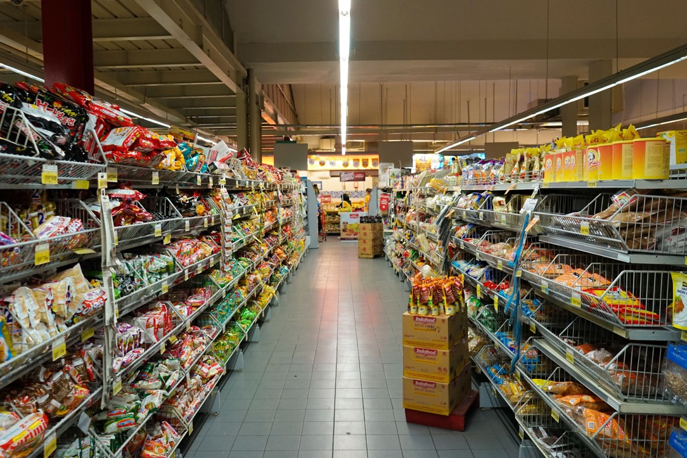


Demand Forecasting for Perishable Goods
Anish Mahapatra | 13th June, 2024

Slide 2

Agenda
01
Defining the Problem Statement
02
Current and Future Scenarios
03
Gathering Data and forming a Hypothesis Tree
04
Data Collection
05
Data Pre-processing, Modelling and Iterations
06
AI Integration for Optimization
07
Deployment & Real-World Impact

Slide 3
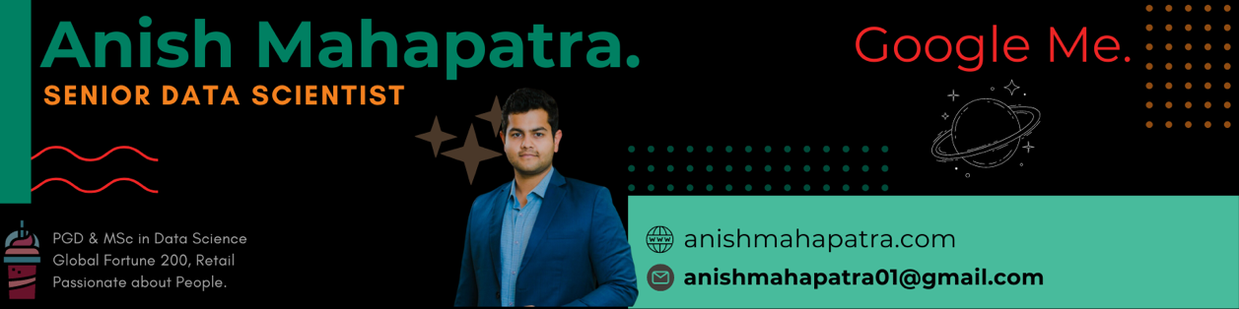







Introduction: Am I worth your time?
Senior Data Scientist
LinkedIn: www.linkedin.com/in/anishmahapatra Medium: anishmahapatra.medium.com Website: www.anishmahapatra.com
GitHub: www.github.com/anishmahapatra
Mentored over 300 people in Data Science
Senior Data Scientist at a Fortune 200 company
Writer, Teacher, Webinar Expert in Data Science
Consultant to 7+ Fortune 500 companies
Subject Matter Expert in multiple Data Science Topics including Chatbots, Kafka, ML & AI
PGD from IIIT Bangalore + MSc in Data Science
7 years of experience in Data Science

Slide 4



Defining the Problem Statement
Aim
Stakeholders
Trigger
Improve demand forecasting accuracy for perishable goods to reduce waste and optimize inventory
Retailers, supply chain managers,
data scientists.
High spoilage rates and
stockouts impacting profitability
and customer satisfaction.
Notes:
APOLLO Hospital Pharmacy Example

Slide 5



Current and Future Scenarios
Current Scenario
Problem: Inaccurate demand forecasts leading to high spoilage and stockouts.
Stakeholder: Retailers and supply chain managers.
Trigger: High operational costs and customer complaints.
Future Scenario
Observation: Reduced spoilage and optimized inventory levels.
Behaviour: Better alignment of supply with demand, improved customer satisfaction.
Insight/Profits: Increased profitability and reduced waste costs.
Notes:
APOLLO Hospital Pharmacy Example

Slide 6





Gathering Data and forming a Hypothesis Tree
01
02
Hypothesis 01
Hypothesis 2
Sales are influenced by historical demand patterns.
Weather conditions significantly affect demand for certain perishables.
03
04
Hypothesis 3
Hypothesis 4
Promotional activities drive short-term spikes in demand.
Holidays and special events cause significant demand variations.
Notes:
APOLLO Hospital Pharmacy Example

Slide 7




Data Collection
Historical Sales Data
Daily/weekly sales records, product categories
Event Calendar
Weather Data
Dates and details of holidays, local festivals, special events
Temperature, humidity, rainfall data from local sources
Promotional Data
Details of past promotions, discounts, and marketing campaigns
Sources: POS systems, online sales platforms, weather APIs, marketing databases, local event listings.
Notes:
APOLLO Hospital Pharmacy Example

Slide 8

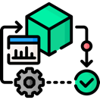

Data Pre-processing, modelling and iterations
Data Processing
Model Selection
Iterations
Handling missing values, outlier detection, normalization.
Feature engineering: creating lag features, rolling statistics.
Time series models: ARIMA, SARIMA.
Machine learning models: Random Forest, Gradient Boosting, LSTM.
Cross-validation, hyperparameter tuning, model evaluation.
Notes:
APOLLO Hospital Pharmacy Example

Slide 9
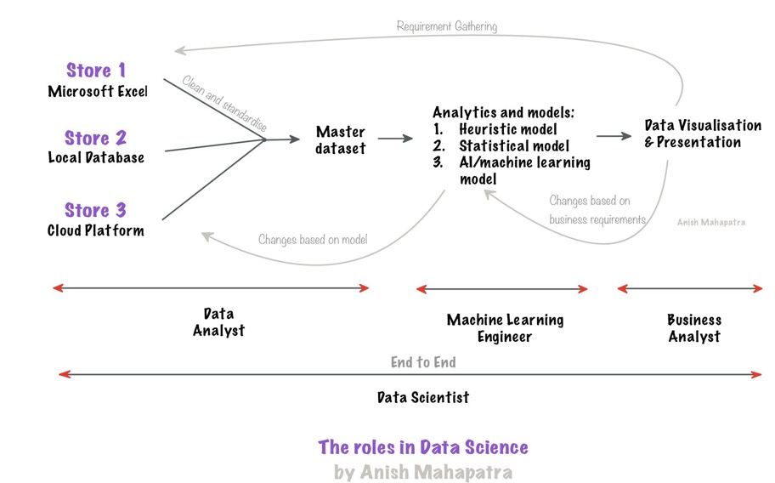
The Real-World Lifecycle.
Notes:
APOLLO Hospital Pharmacy Example

Slide 10





Topic 3 of 6
Components of the Master’s Degree
Q. What do you really want from a Master’s Degree?
01
02
All Companies should
recognize my degree
My Degree should be
Recognized globally
Companies like Amazon, Microsoft, Fortune 500:
all recognize this as a full-fledged
Post graduate and Master’s Degree
India or Abroad, everyone should recognize my degree. This is possible because of the WES Certification
04
03
I should be able to get a transition my job or get a jump in my salary
Possibility of
Higher Studies
On Average, having a relevant MSc Degree will get you 40% more in the market
If you wish, you should be able to pursue even higher degrees later
Notes:
Source:https://www.payscale.com/research/IN/Job=Data_Scientist/Salary

Slide 11



AI Integration for Optimization
Using AI for Data Insights
LLMs for Pattern Recognition
Open Source and Cloud AI Solutions
AI tools for advanced data analysis, feature extraction.
NLP for sentiment analysis, customer feedback.
Example: Using GPT-4 for analyzing customer reviews & predicting demand shifts.
Platforms like TensorFlow, PyTorch for model development.
Cloud services like AWS, Google Cloud AI for scalability.
Example: Implementing TensorFlow models on Google Cloud for real-time forecasting.
Leveraging LLMs like GPT-4 for anomaly detection and pattern recognition.
Example: Fine-tuning LLMs to analyze large datasets for demand prediction.
01
02
03
Notes:
APOLLO Hospital Pharmacy Example

Slide 12
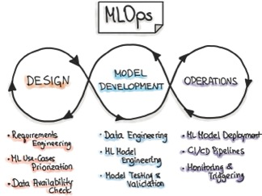


Real-World Impact
Deployment Strategies
Monitoring and Feedback
Evaluation Metrics
Integrating the model into the inventory system using APIs.
Using Docker for containerization to ensure seamless deployment.
Technical Info: Dockerfile setup, CI/CD pipelines.
Continuous tracking of model accuracy, detecting model drift.
Automated re-training based on feedback.
Technical Info: Monitoring tools, alert systems.
RMSE, MAE, MAPE for performance evaluation.
Continuous improvement through A/B testing and feedback loops.
Notes:
APOLLO Hospital Pharmacy Example

Slide 13

Demand Forecasting for Perishable Goods
Anish Mahapatra
Let’s Talk!
LinkedIn: www.linkedin.com/in/anishmahapatra
Email: anishmahapatra01@gmail.com

Slide 14

Topic 1 of 6
Q&A Session
Let’s Talk!
Senior Data Scientist
LinkedIn: www.linkedin.com/in/anishmahapatra Medium: anishmahapatra.medium.com Website: www.anishmahapatra.com
GitHub: www.github.com/anishmahapatra

